Slide 1
BLEEDING Practical lesson № 1

Slide 2
Types of temporary of stop bleeding
Elevated position of the injured extremity
Direct pressure on the cut or wound
Pressure bandage
Pressure at the «pressure point»
Tourniquet

Slide 3
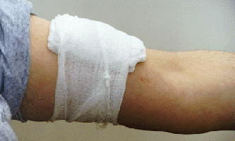
The imposition of a PRESSURE BANDAGE
Indication:
venous bleeding
capillary bleeding
arterial bleeding from medium and small arteries

Slide 4
Pressure bandage. Algorythm:
Expose the wound by removing or cutting the victim‘s clothing to find the source of the bleeding.
Processing the wound surface.
Place a sterile gauze pad on the wound.
Place roller gauze bandage (or clean cloth) tightly over dressing.
Fix with bandage.

Slide 5
The imposition of a pressure bandage

Slide 6
Do not apply a pressure bandage so tightly that it cuts off circulation.
Check the radial pulse if the bandage is on an arm; For a leg, check the pulse between the inside ankle bone knob and the Achilles tendon (posterior tibial).
The use of a pressure bandage where the soft tissues are thin in the bones (the head, the fields of radiocarpal, elbow, knee and ankle joints, the anterior surface of the tibia).
The compression bandage compresses the gaps of damaged vessels, this decreases blood flow to extremities and reduces pressure in the veins, which contributes to the rapid formation of blood clots.
You can stop the bleeding by this method.

Slide 7
Pressure at the «pressure point»
When there is massive arterial bleeding, every second counts. Stop massive arterial bleeding should always begin with a finger pressed against the artery at "pressure point" to slow the blood flow. For this palpable arterial pulsation, which finger is pressed against the bone for a short time required for applying a pressure bandage, tourniquet or twist.
A «PRESSURE POINT» is where an artery near the skins surface passes close to a bone, against which it can be compressed.

Slide 8
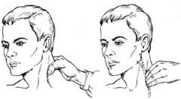
Stop bleeding from wounds of the head and neck:
With a strong arterial bleeding from the upper half of the neck is compression of the carotid artery.
1 way: To do this, press the carotid artery with the thumb of your hand on the side of his throat on the edge of the sternocleidomastoid muscle transverse process of VI cervical vertebra, clasping his fingers lateral and posterior surface of his neck.
2 way. If the person is behind the wounded man, pressing the carotid artery produced by pressure on the anterior surface of the neck beside the larynx with four fingers, while the thumb wraps around the back of the neck of the victim.

Slide 9
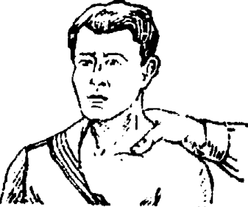
When bleeding from wounds of the head, shoulder joint and neck (excluding carotid arteries)
If the victim is lying on the back (assisting is facing him), then you must turn your head wounded in the side opposite the damage. Four fingers clasp the back of the neck, and the thumb to press the bleeding artery to the edge.
Press the subclavian artery by the first rib in the supraclavicular fossa outwards from the location of attachment of the sternocleidomastoid muscle to the sternum.

Slide 10
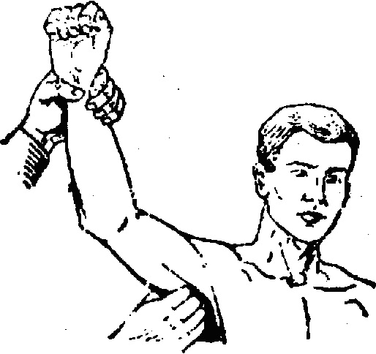
When bleeding in the upper part of the shoulder
Press the axillary artery in the axillary fossa to the humeral head.
To do this, put one hand on the injured shoulder joint and hold the joint in a stationary state, the four fingers of the other hand with a force to press the axillary artery to the head of the humerus on the border of the anterior thirds of the axilla.

Slide 11
When bleeding from the lower and middle thirds of the arm and forearm:
Press the brachial artery to the humerus at the inner edge of two-headed muscle. To do this, lift the injured arm upward. In position behind the patient, place the four fingers of the hand on the inner surface of the shoulder at the edge of two-headed muscle, and the thumb on the outside of the shoulder. Then pressed against the brachial artery to the humerus at the same time with the thumb .

Slide 12
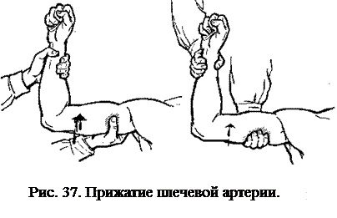

Slide 13
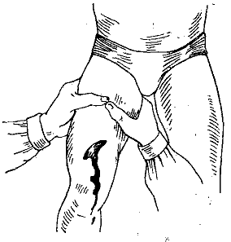
When bleeding from the vessels of the femur and tibia:
The femoral artery is pressed against the middle of the lower third of the inguinal ligament to the horizontal branch of the pubic bone with four fingers or a fist. The pressure increase with second hand, using the weight of his body. Femoral artery at the fat people can be pressed by knee.

Slide 14
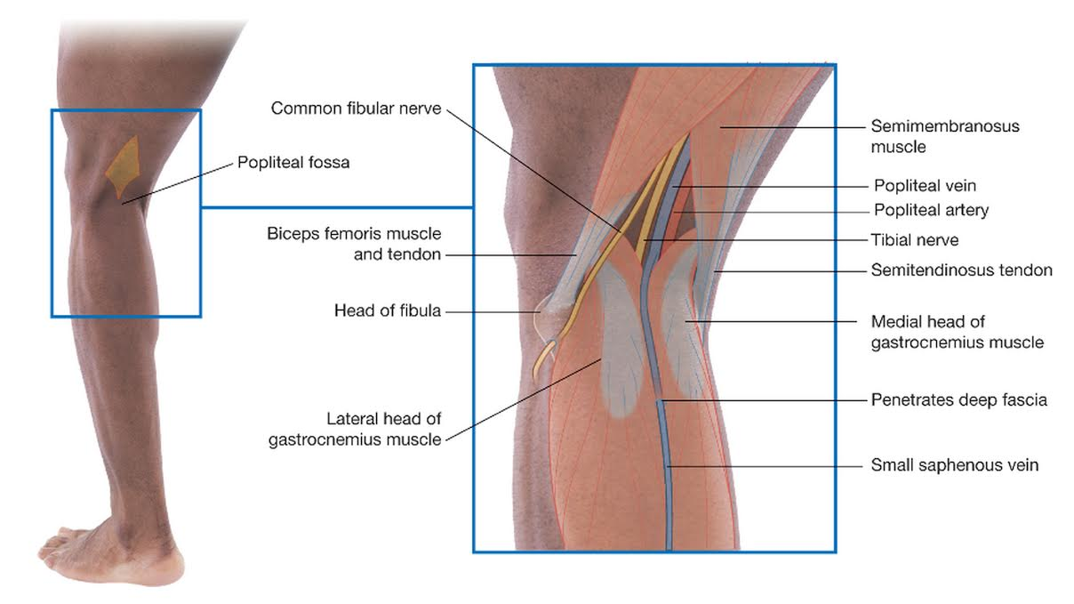
When bleeding from the vessels of the Shin:
Squeeze the popliteal artery to the posterior surface of the tibia in the middle of the popliteal fossa.

Slide 15
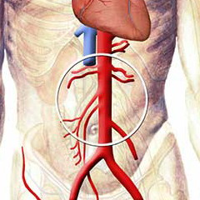
The bleeding in the wound of the abdominal aorta
The bleeding in the wound of the abdominal aorta can stop with strong pressing of the abdominal aorta to the spine with a fist to the left of the navel, using the entire weight of the body.

Slide 16
The applying a tourniquet
Indications:
Major arterial bleeding
Limb amputation

Slide 17
Applying a tourniquet. Algorythm:
Give limbs an elevated position.
The wiring is not superimposed on the naked skin — required lining — towel, napkin, sleeve shirt.
Apply the tourniquet between the heart and injury. Place the tourniquet 4 to 5 cm from the edge of the wound site. Never place it directly over a wound or fracture or directly on a joint (wrist, elbow, or knee). For wounds just below a joint, place the tourniquet just above and as close to the joint as possible. Next to the stubs of the harness it is impossible to impose (with the separation of the limb), superimposed above, not closer than 20cm.
Stretched a tourniquet is applied to extremity . The first round is done with great tension, the subsequent tours — fixing, with diminishing tension.
Evaluate the correctness tourniquet
Fix the time of the Applying a tourniquet.
DO NOT cover the tourniquet--you should leave it in full view.

Slide 18
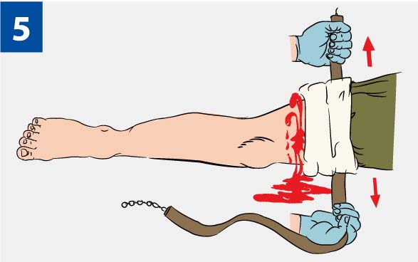
A tourniquet was applied correct if:
The cessation of bleeding
The absence of pulsation in the distal extremity of limb
Limb is pale and cold

Slide 19
Typical places tourniquet Esmarch

Slide 20
Mistakes in tourniquet:
The tourniquet is used without the evidence, i.e., bleeding can be stopped by other methods
The tourniquet is used on a naked body.
The tourniquet is tighten slightly, as a result the veins are compressed, there is venous stasis, which leads to increased bleeding from the wound.
Damage of the nerve trunks with the development of paralysis and necrosis due to severe dragging a bundle of limbs.
The absence of notes with the time of tourniquet application (in hours and minutes).
Tourniquet is obscured by clothing or a bandage.

